Slide 1
Housing Prices in Texas
Giovani Valladares Giron

Slide 2
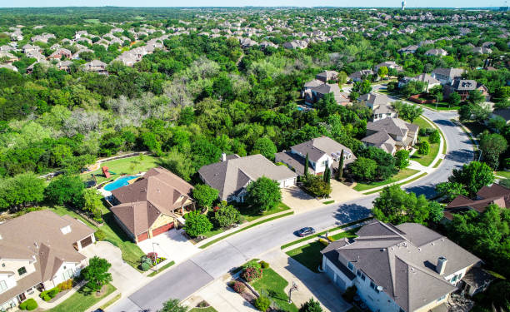
What are we looking at?
This dataset looked at houses in Texas and California what state they were in in terms of space, age, property tax, and other elements through zillow and their price .
During cleaning, only Texas homes remained

Slide 3
What are we hoping to answer?
By using other elements of the house, can we predict how expensive a house will be?
Examples of Data used on the homes
Bedrooms
Bathrooms
For Sale, Sold, Recently Sold, Other
Living Space
Value of living space (As per Zillow)
Property Tax

Slide 4
Regression Results
Results Coefficients
307442.02
-93751.17
194.01
.54
241
Intercept
Amount of Bedrooms
Living Area in Sq ft
Adjusted R Squared
Observations
Notes:
All categorical data was removed
Inside Cleaned Data, almost all houses were 4-5 bedrooms

Slide 5
Conclusions
Model Fit
Skewed Data
Practical Use
The model sat at a .54 R Squared, meaning that almost half of the data is not explained by the model
The data itself only have houses that had 3 bedrooms and 2 bathrooms and the cleaning left only houses with more that 5 bedrooms.
The fact that the model reduced price when more bedrooms were added makes it seem like the model is off in a major way

Slide 6
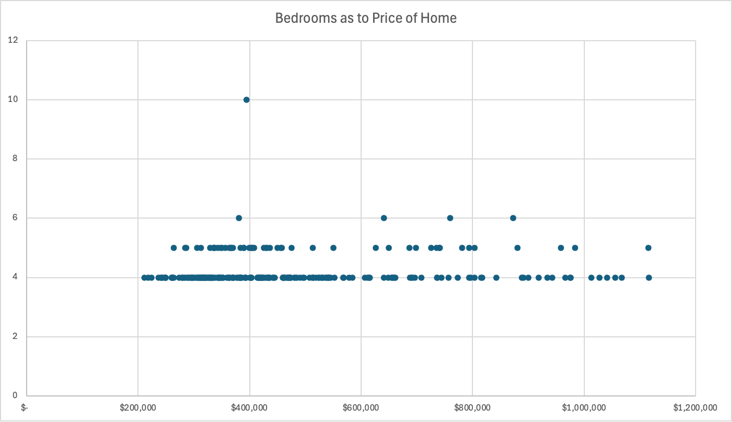
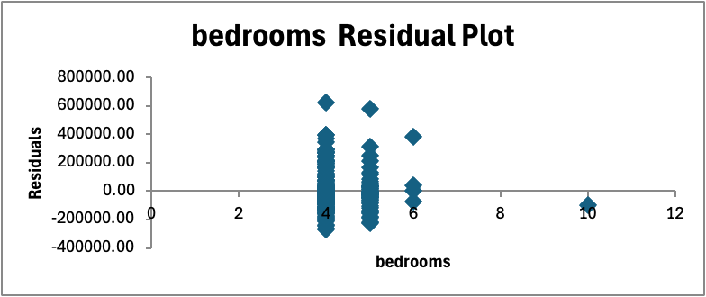
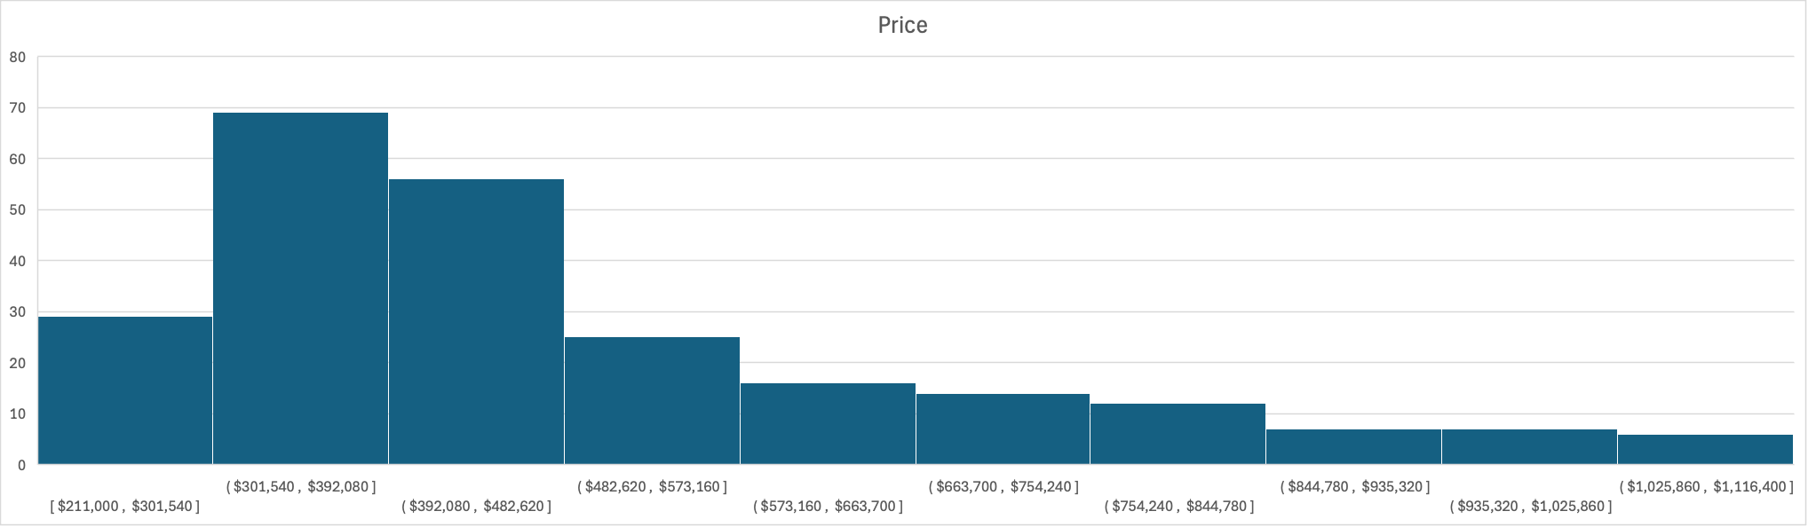
Additional Graphs

